Slide 1
Help the Owner/ Help Yelp
CXC180023 - Chin-Kuei, Chang
SXS171530 - Sreeharsha Prem Kumar, Sreeram
VXU180002 - Vikalp Upadhyay

Slide 2


Running a Business
How to start a new business? What to do to improve the performance?
Location
Where should I open a new store?
What store already are near by?
Category
What kind of business I am going to run?
Review
What people care? Expense/service?
Do people have different expectation to different kind of stores?

Slide 3
Implementation environment
Computing environment: 1. Hardware: Intel Core i7, 16 GB DDR4 RAM 2. Software: Anaconda 3. Operating System: Windows 10
B. Software tools used in analysis:
Jupyter
C. Python:
1. Version 3.7
2.Libraries:
i. Numpy
ii. Pandas
iii. Json
iv. Os
v. Gc
vi. Time
vii. Warnings
viii. Matplotlib
ix. Seaborn
x. Network
xi. Heapq
xii. Datetime
xiii. Folium
xiv. Plotly
xv. calander

Slide 4
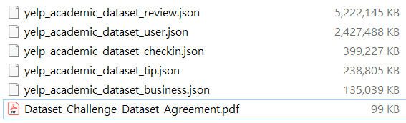
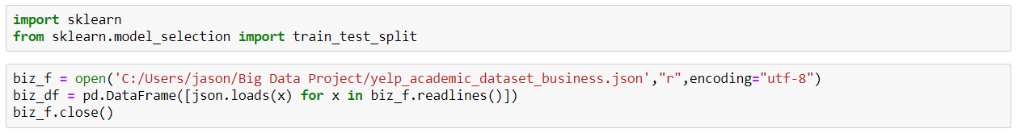
Introduction of the Data Set
Yelp Dataset Challenge : a subset of Yelp's businesses, reviews, and user data.
Convert json format to csv

Slide 5
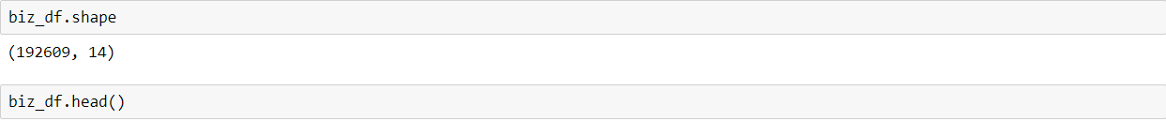
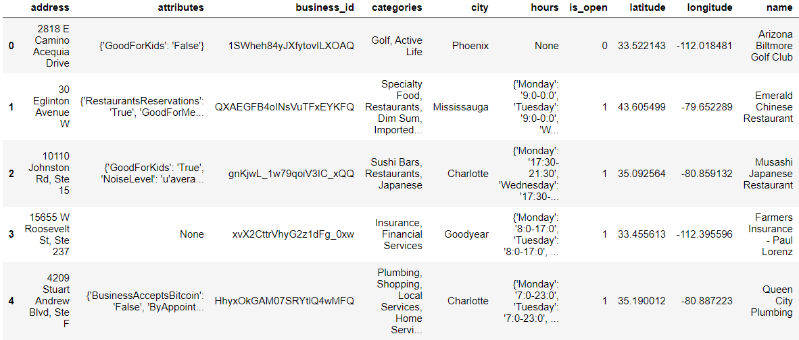
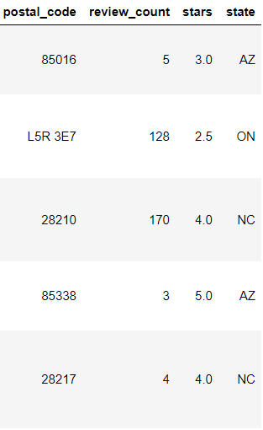
Introduction of the Data Set
Dataset _ Business
With 14 columns and 192,609 rows.
Variables : address, attributes, business_id, categories, city, hours, is_open, latitude, longitude, name, postal_code, review_count, stars, state
Notes:
// string, 22 character unique string business id "business_id": "tnhfDv5Il8EaGSXZGiuQGg", // string, the business's name "name": "Garaje", // string, the full address of the business "address": "475 3rd St", // string, the city "city": "San Francisco", // string, 2 character state code, if applicable "state": "CA", // string, the postal code "postal code": "94107", // float, latitude "latitude": 37.7817529521, // float, longitude "longitude": -122.39612197, // float, star rating, rounded to half-stars "stars": 4.5, // integer, number of reviews "review_count": 1198, // integer, 0 or 1 for closed or open, respectively "is_open": 1, // object, business attributes to values. note: some attribute values might be objects "attributes": { "RestaurantsTakeOut": true, "BusinessParking": { "garage": false, "street": true, "validated": false, "lot": false, "valet": false }, }, // an array of strings of business categories "categories": [ "Mexican", "Burgers", "Gastropubs" ], // an object of key day to value hours, hours are using a 24hr clock "hours": { "Monday": "10:00-21:00", "Tuesday": "10:00-21:00", "Friday": "10:00-21:00", "Wednesday": "10:00-21:00", "Thursday": "10:00-21:00", "Sunday": "11:00-18:00", "Saturday": "10:00-21:00" } }

Slide 6
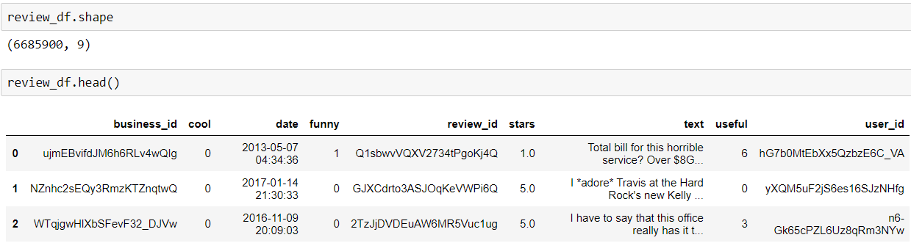
Introduction of the Data Set
Dataset _Review
With 9 columns and 6,685,900 rows.
Variables : business_id, cool, date, funny, review_id, stars, text, useful, user_id
Notes:
// string, 22 character unique review id "review_id": "zdSx_SD6obEhz9VrW9uAWA", // string, 22 character unique user id, maps to the user in user.json "user_id": "Ha3iJu77CxlrFm-vQRs_8g", // string, 22 character business id, maps to business in business.json "business_id": "tnhfDv5Il8EaGSXZGiuQGg", // integer, star rating "stars": 4, // string, date formatted YYYY-MM-DD "date": "2016-03-09", // string, the review itself "text": "Great place to hang out after work: the prices are decent, and the ambience is fun. It's a bit loud, but very lively. The staff is friendly, and the food is good. They have a good selection of drinks.", // integer, number of useful votes received "useful": 0, // integer, number of funny votes received "funny": 0, // integer, number of cool votes received "cool": 0

Slide 7
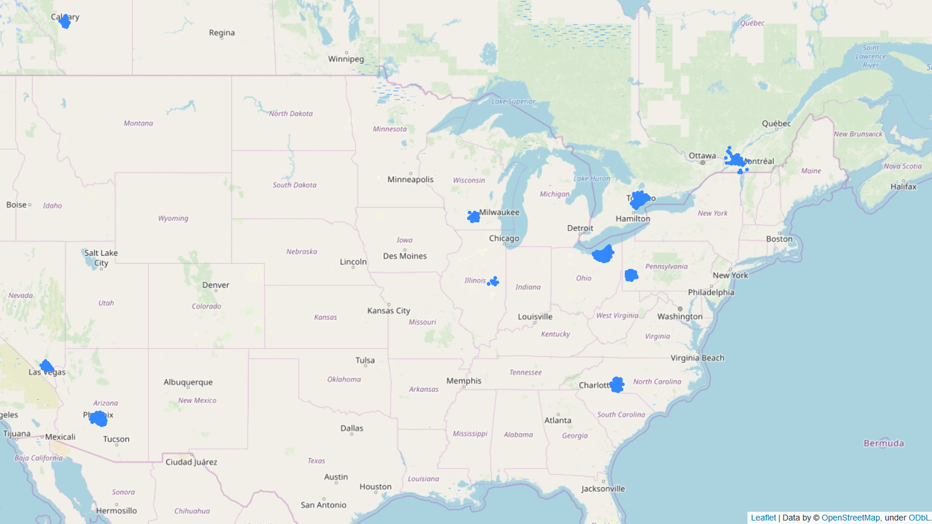
Distributions of Businesses in North America

Slide 8
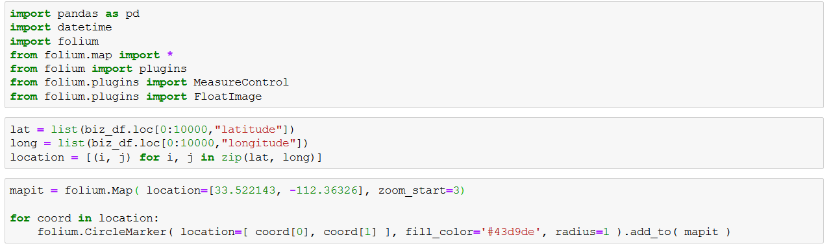
Distribution of Businesses

Slide 9
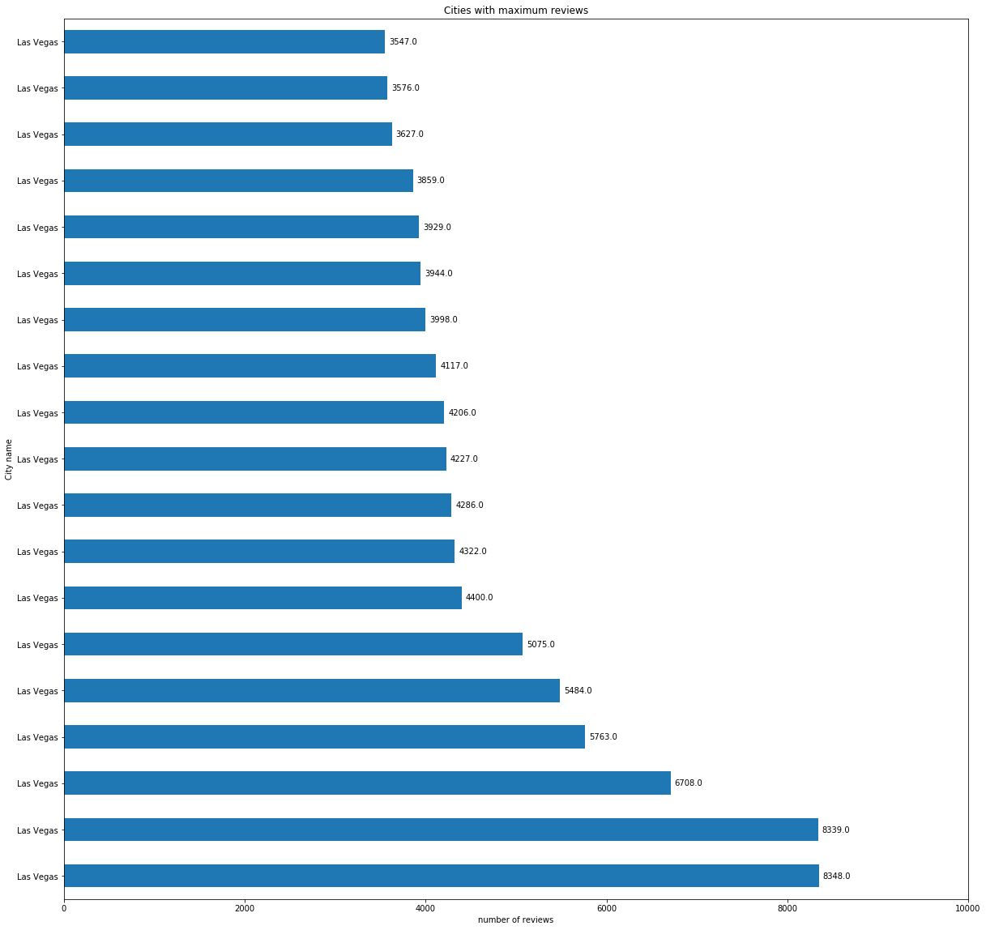
Cities with most reviews for different categories

Slide 10
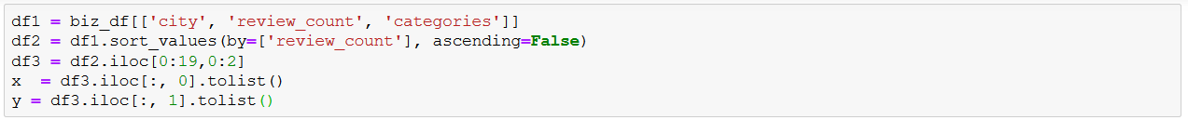
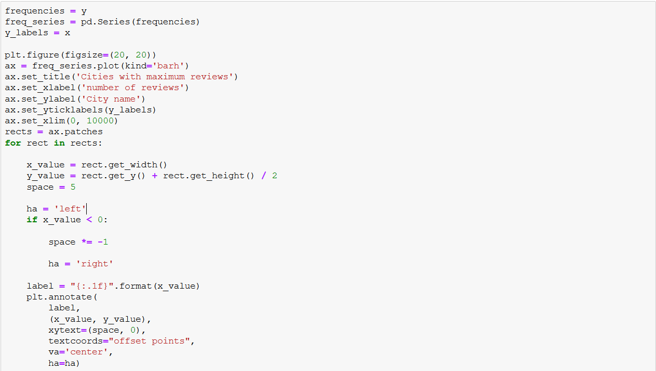

Slide 11
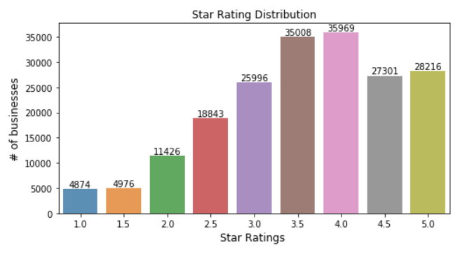
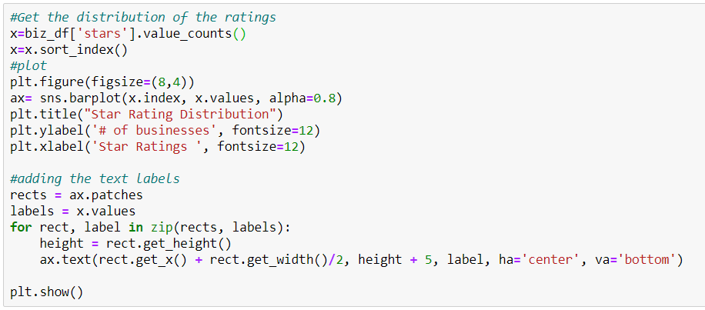
Star Rating Distribution

Slide 12
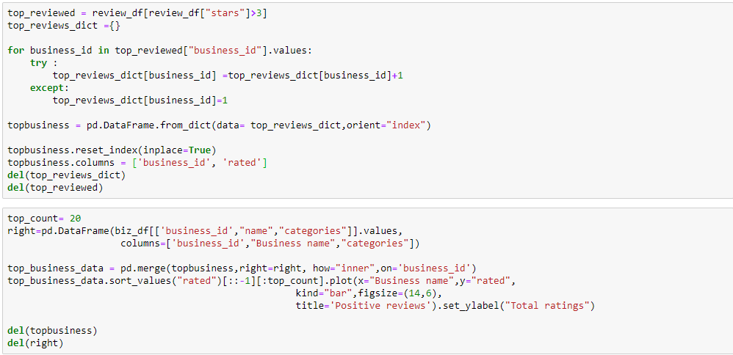
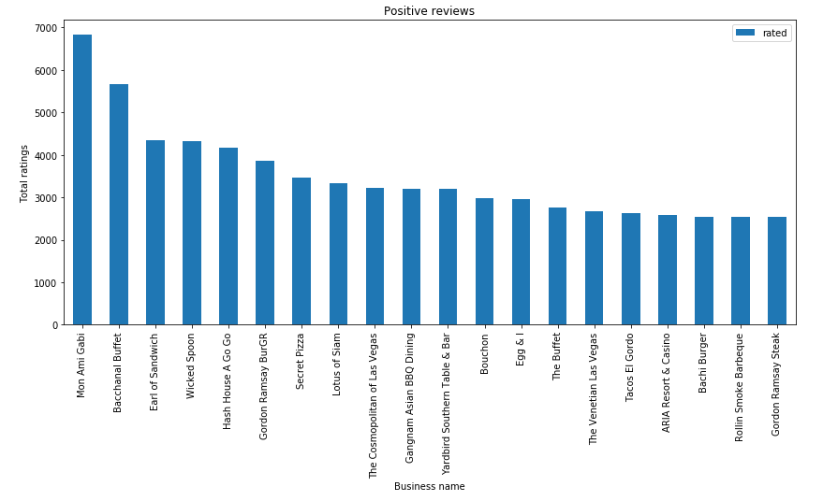
Business Having Most Positive Rates
※ Stars is greater than 3

Slide 13
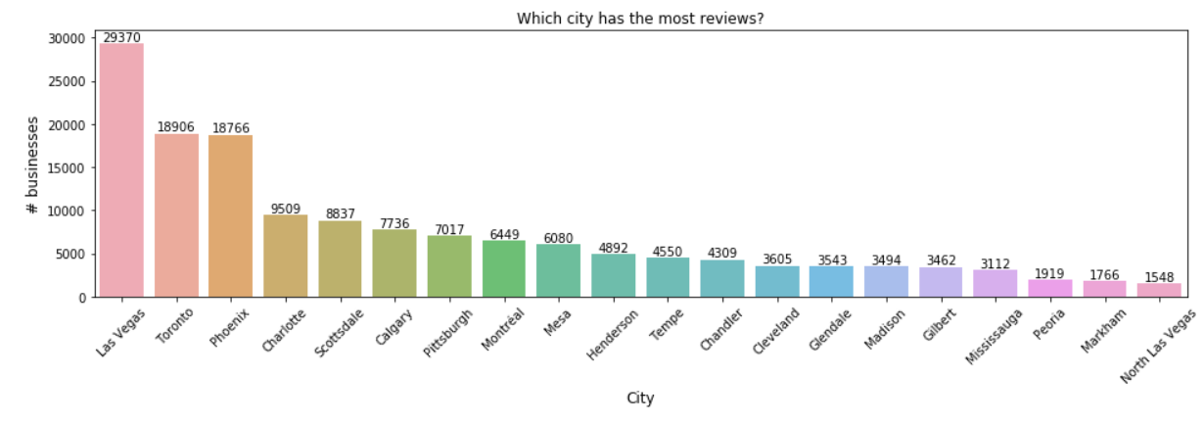
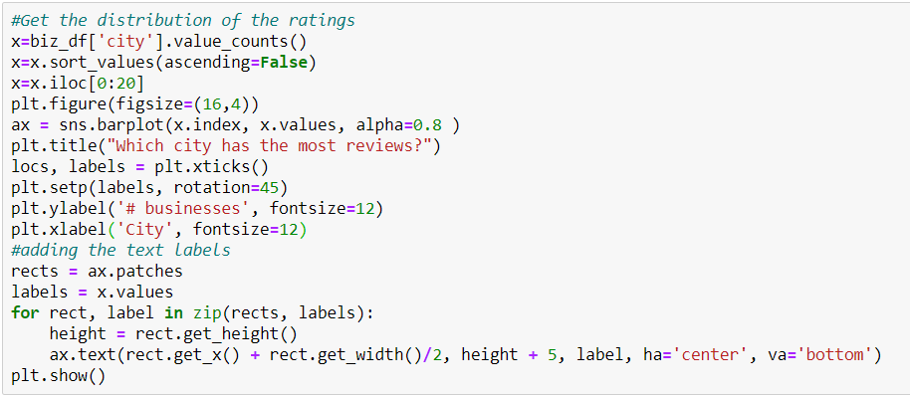
Review Distribution / by City

Slide 14
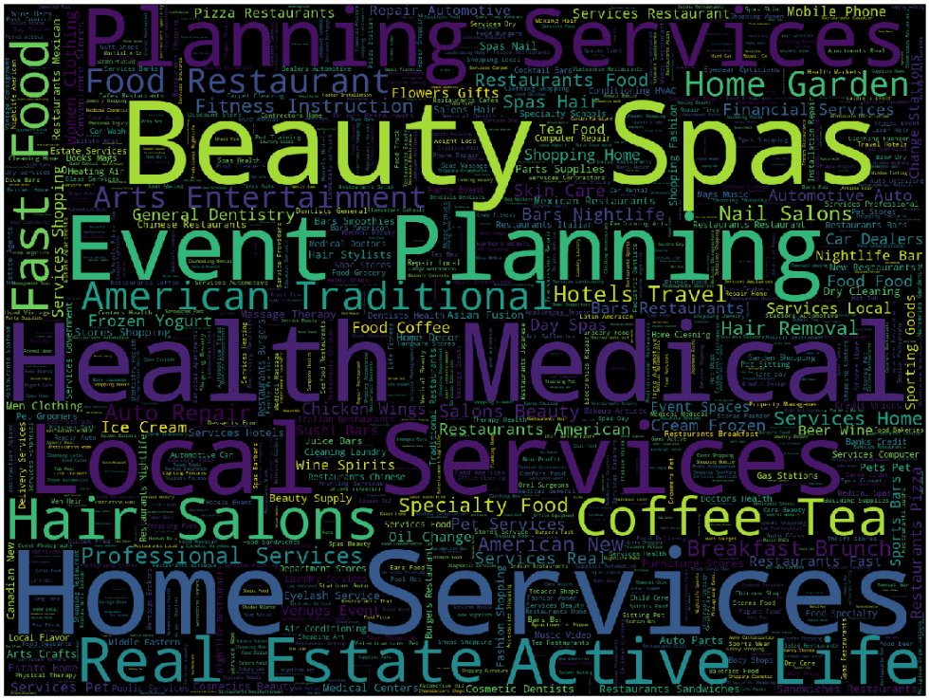
Worldcloud - categories

Slide 15
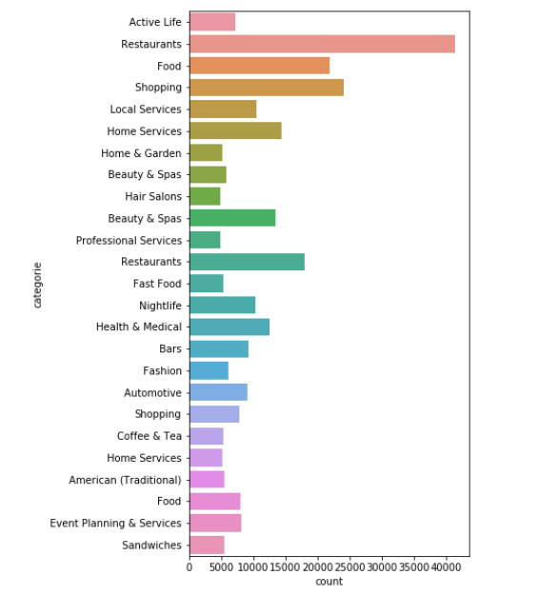
Different Business Categories
Different kinds of business categories Restaurants top list

Slide 16
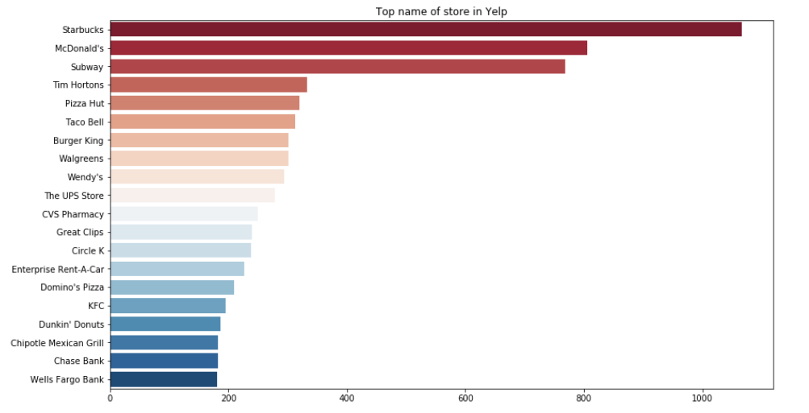
Top franchise store with number of stores
Starbuck franchise has highest number of stores in the yelp data

Slide 17
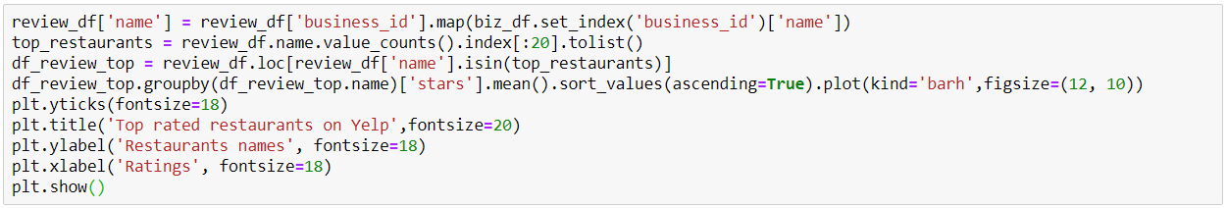
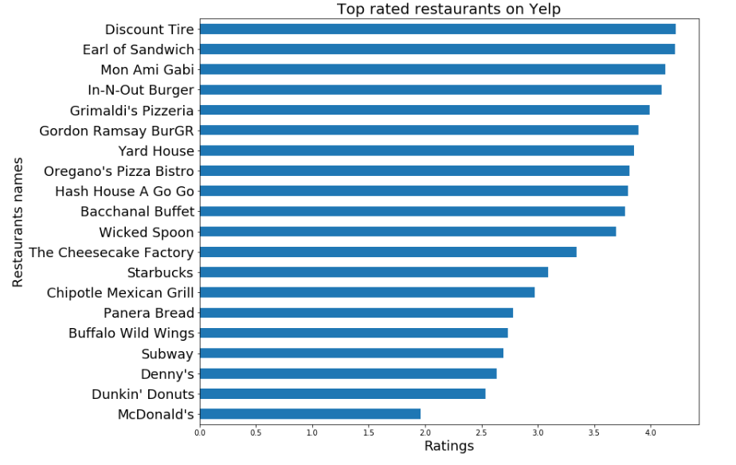
Top rated business on Yelp

Slide 18
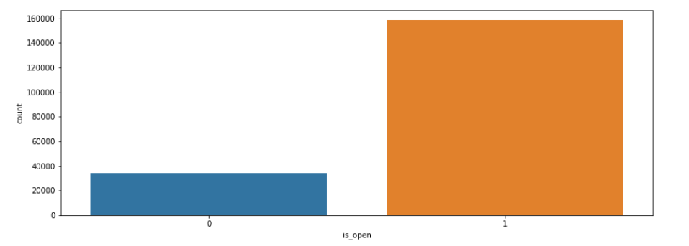
How many Business are open ?
Around 80% of the business are open and currently operating.

Slide 19
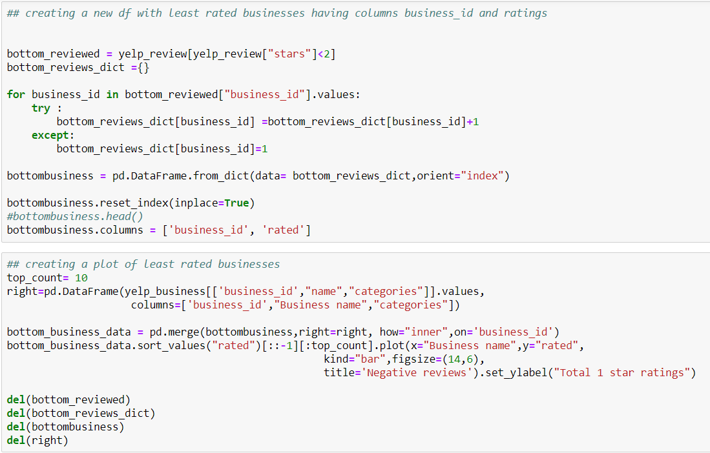
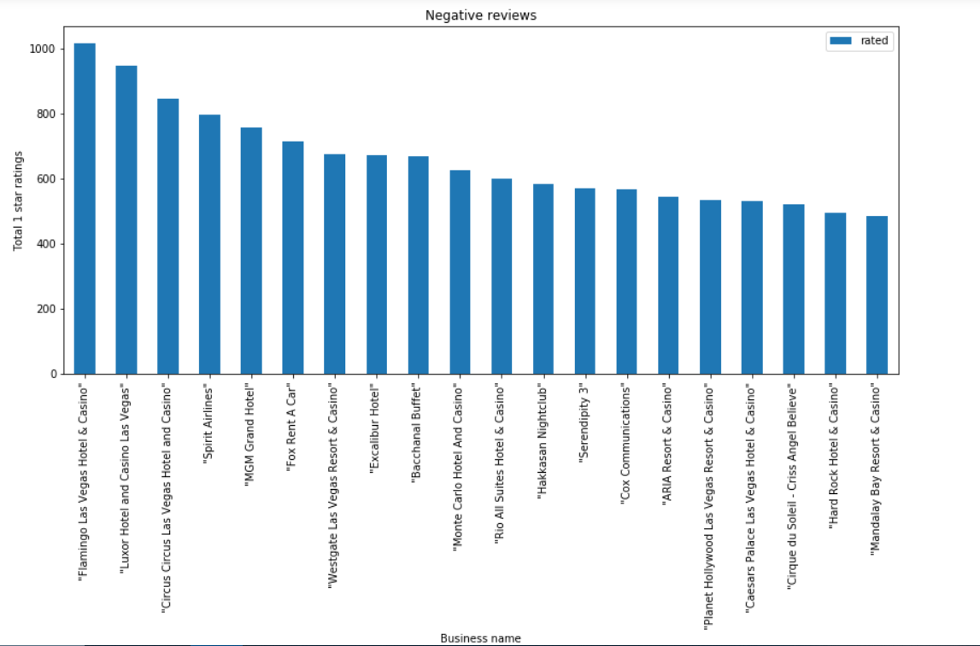
Least Rated Businesses

Slide 20
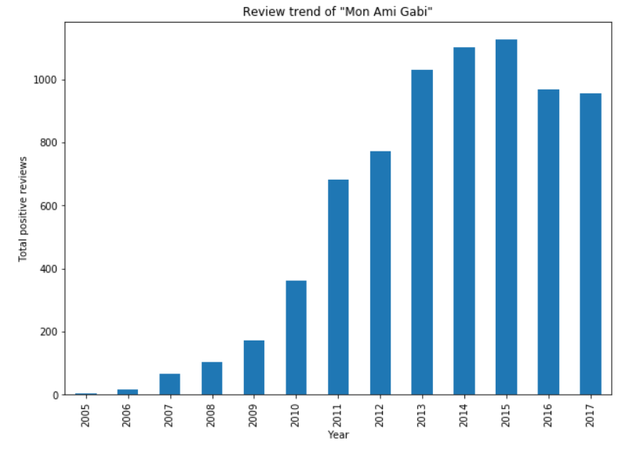
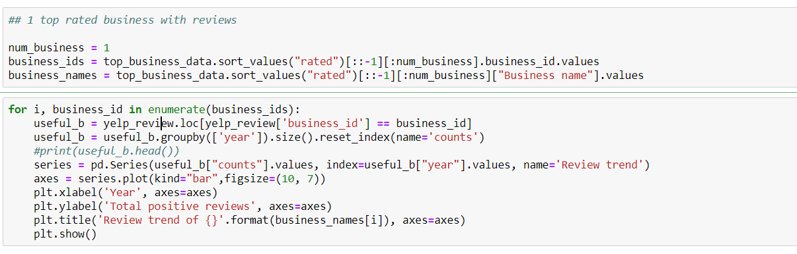
Review Trend of Top-Rated Business

Slide 21
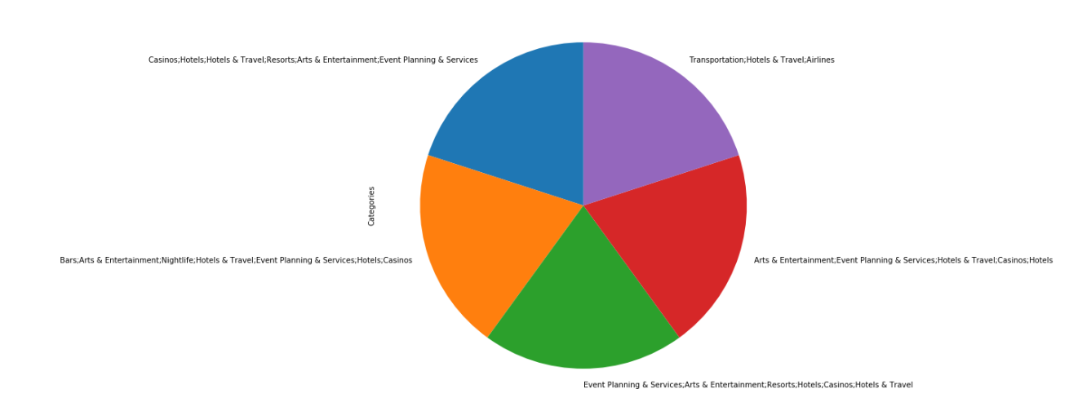
Bottom Rated Categories

Slide 22
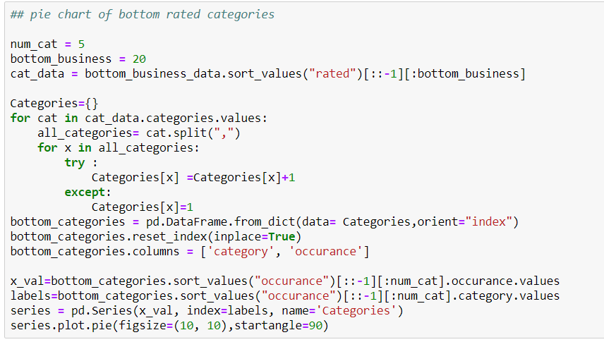
Bottom Rated Categories

Slide 23
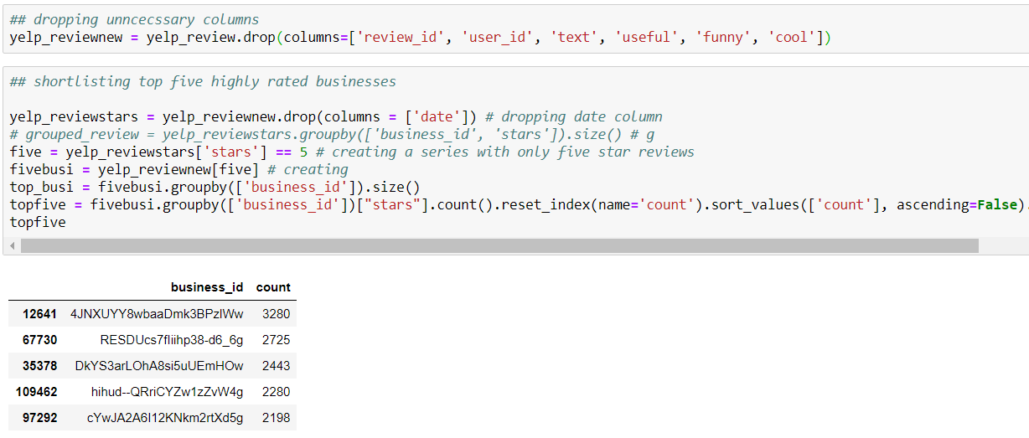
5 Top Rated Businesses

Slide 24
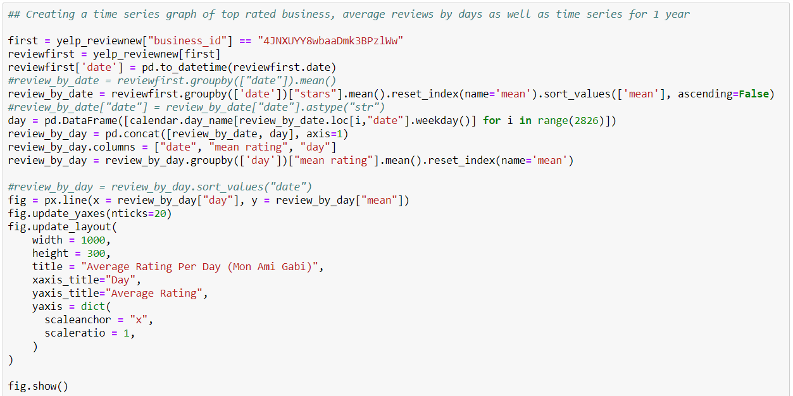
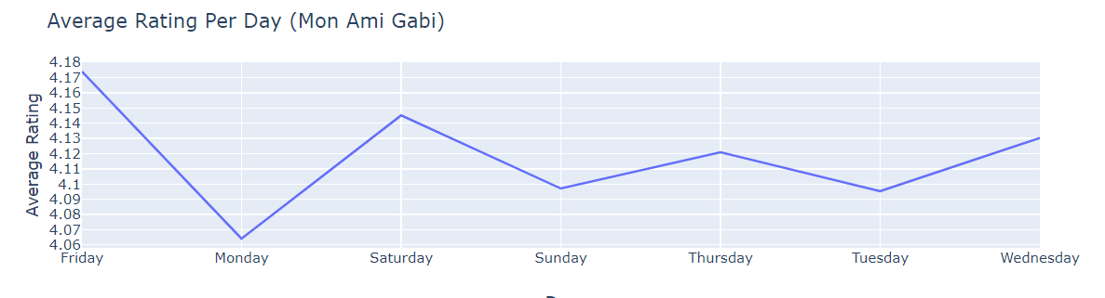
Average reviews per day for Mon Ami Gabi

Slide 25
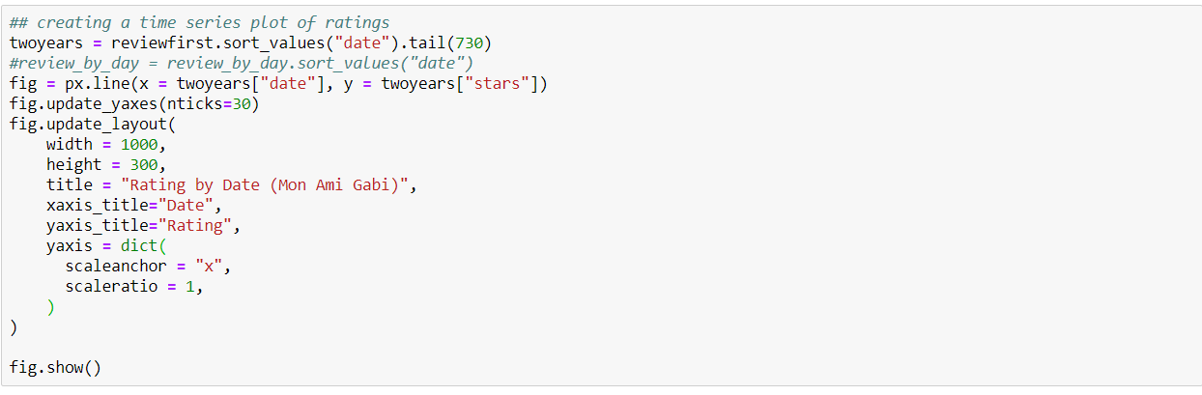
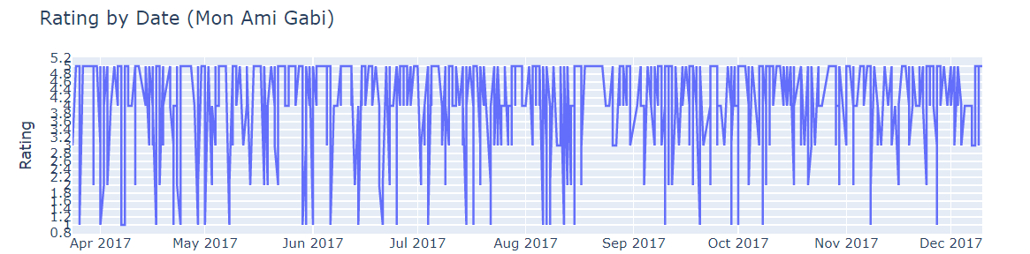
Reviews over one year

Slide 26
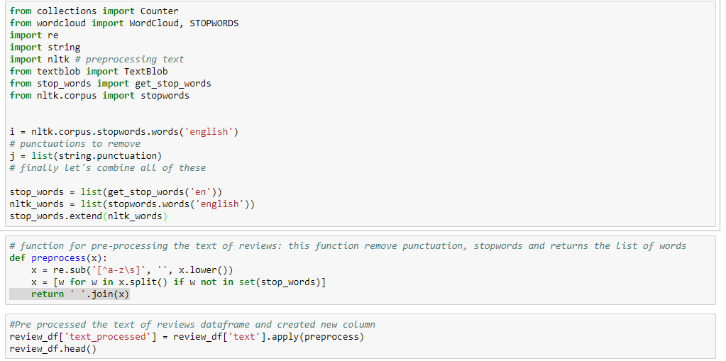
Review Data pre processing
A stop word is a commonly used word (such as “the”, “a”, “an”, “in”) which can be ignored in the review text
NLTK(Natural Language Toolkit) in python has a list of stopwords
Notes:
major forms of pre-processing is to filter out useless data. In natural language processing, useless words (data), are referred to as stop words.
NLTK(Natural Language Toolkit) in python has a list of stopwords stored

Slide 27
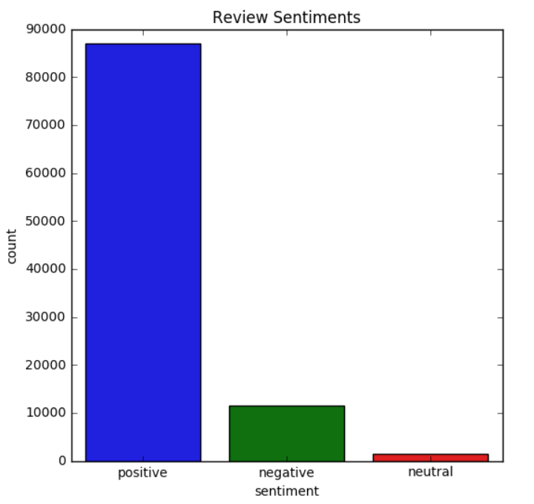
Review Sentiments
Notes:
Used TextBlob Sentiment Analysis
Polarity is float which lies in the range of [-1,1] where 1 means positive statement and -1 means a negative statement.
review_df['text_sentiment'] = review_df['text_processed'].apply(sentiment)
review_df['sentiment'][review_df['text_sentiment'] > 0] = 'positive'
review_df['sentiment'][review_df['text_sentiment'] < 0] = 'negative'
review_df['sentiment'][review_df['text_sentiment'] == 0] = 'neutral'

Slide 28
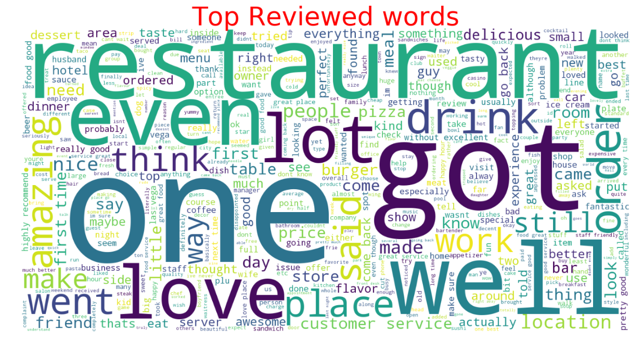
Top Reviewed words
Notes:
represent the frequency or the importance of each word.
Restaurant
Drink
Amazing
Love
Well
Lot
If you see the top words in reviews

Slide 29
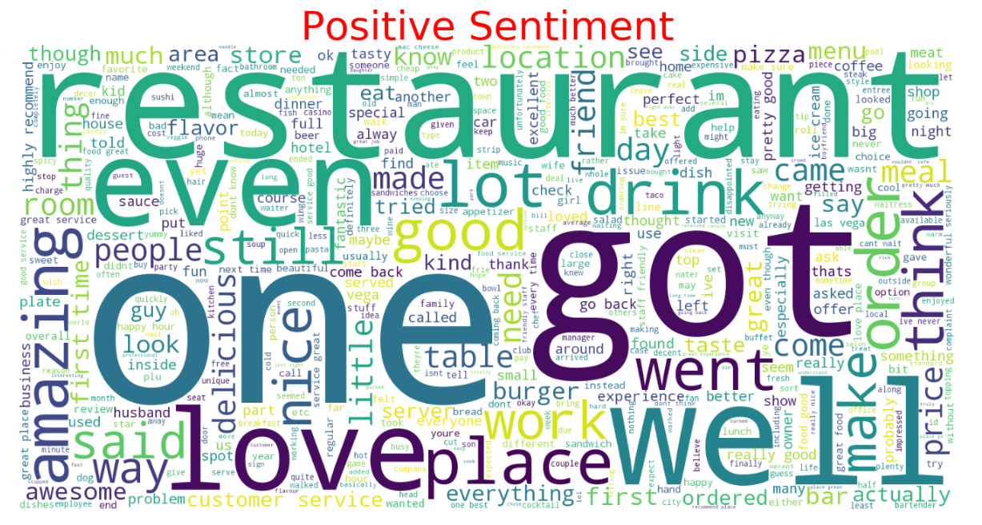
Top words in Positive Sentiment reviews

Slide 30
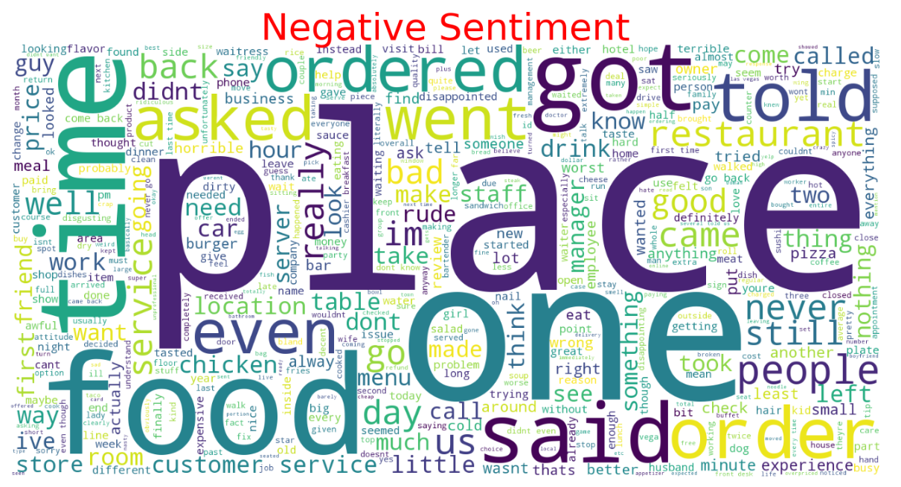
Top words in Negative Sentiment reviews

Slide 31
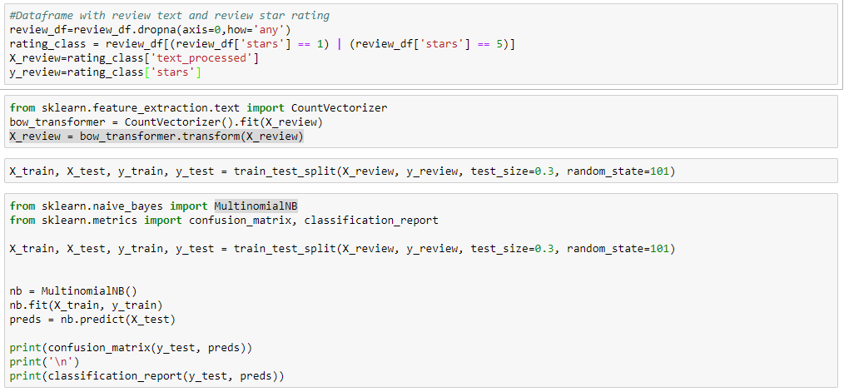
Multinomial naive bayes
Notes:
The multinomial Naive Bayes classifier is suitable for classification with discrete features (e.g., word counts for text classification).
The multinomial distribution normally requires integer feature counts. However, in practice, fractional counts such as tf-idf may also work.
constructing a word count matrix from raw text is not part of naive bayes so used CountVectorizer sklearn.feature_extraction.text

Slide 32
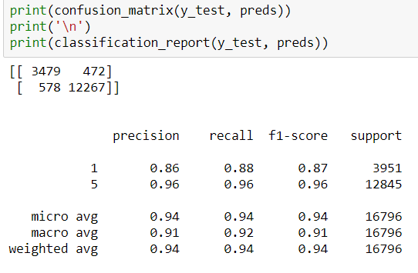
Classification Report

Slide 33
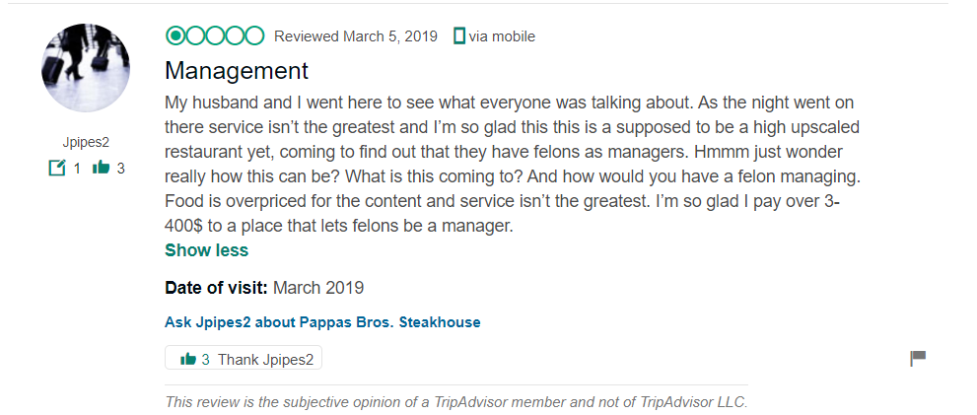
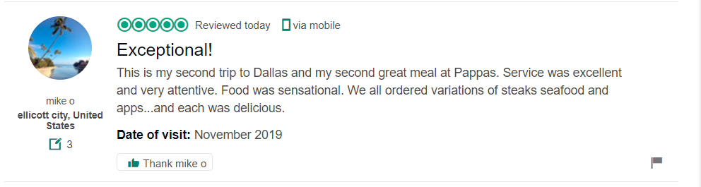
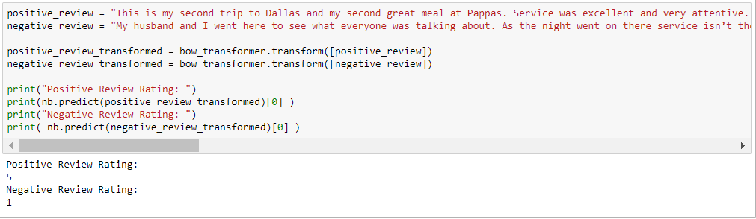
Model predicting rating based on reviews from other sources
xi. Heapq

Slide 34
Conclusion
Using the MultinomialNB (multinomial Naive Bayes) we got accuracy of 96% for positive reviews and 86% for negative reviews.
We got decently accurate model with the yelp reviews text data and our goal was 'what business problem is this model helping to solve?'. We put thought into this and came up with below scenarios where this model will be useful for the business owners and yelp
Eliminate mislabeled data
Identify spam of negative reviews (intervention check)
Predicting general sentiment using social media feeds
Notes:
Eliminate mislabeled data
While exploring the data we found that for some of the positive reviews are labeled as 1 star and some of the negative reviews labeled as 5 star. This might be due to misclick or error so using this model if we can predict the review being a positive but rating is 1 then we can suggest the user to verify the rating before submission. This will be quite useful for Yelp in getting the correct information.
Identify spam of negative reviews (intervention check)
Another potential use of this model is if we identify high number of negative reviews being spammed within short span of time or if anyone wants to vent on the restaurant by posting multiple reviews , flagging them for further review instead of posting them based on the words used in reviews will be helpful especially for new business owners.
Predicting general sentiment using social media feeds
Another use case where this model can be used is to scrape the social media feed or blogs and find the current mood or sentiment of the content being posted where specific star rating might not be available.

Slide 35
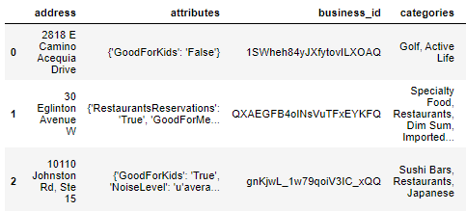
Future Work
※ Improving in “Categories Analysis”
For example, the Categories of CVS is “grocery; pharmacy; photo”, while Walmart is “grocery; pharmacy; key making”. And we can not comary the two companies at the same time. We have to make some changes for defining categories as below.
Company | grocery | pharmacy | photo | keymaking
CVS | 1 | 1 | 1 | 0
Walmart | 1 | 1 | 0 | 1

Slide 36
Future Work
※ Improving in giving suggestion to “rating change in time”
※ Predicting the general sentiment using social media feed
※ Finding statistically significant variables

Slide 37


